Slide 1
MugShot
Tight Pickle Productions

Slide 2
Team introduction Tight Pickle Productions
Rob O’Connor (Artist)
Georgi Statev (Artist)
Rick Oosthof (Designer)
Dominique de Graaff (Designer)
Glyn Leine (Engineer)

Slide 3
Concept Discription
Target Group
Synopsis
Main goals

Slide 4
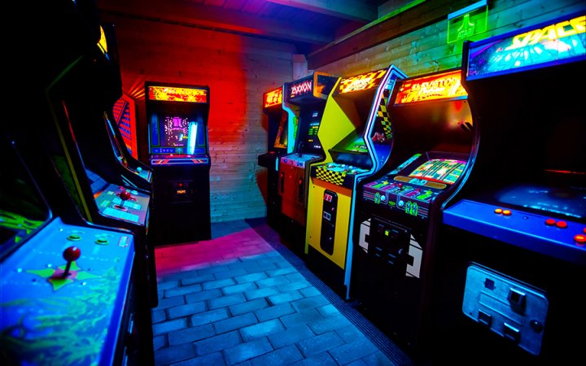

One- Pager
What is an Arcade Game?
Value Proposition: Shoot the brute, get the girl.
Competitor Analysis

Slide 5
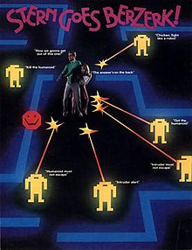


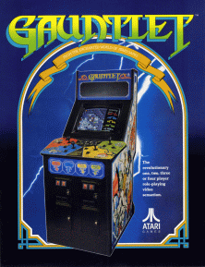



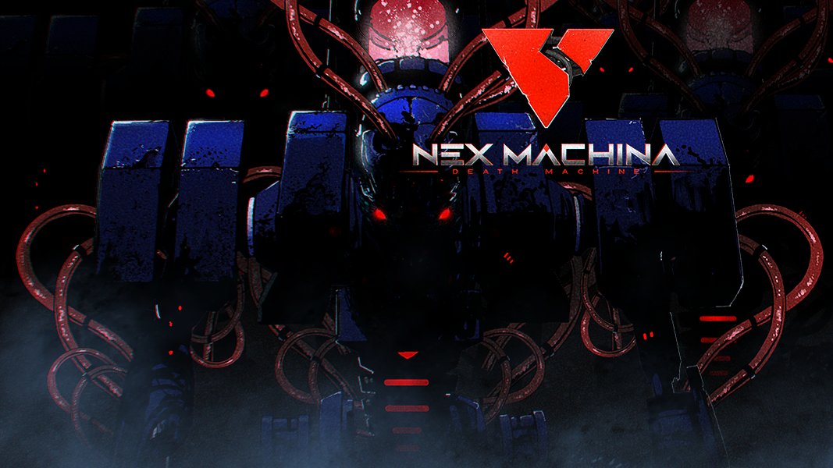

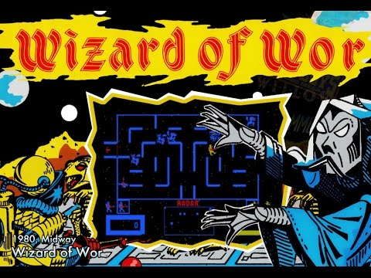
References
Notes:
Arcade Game. (2018). In Merriam-Webster’s online dictionary. Retrieved from https://www.merriam-webster.com/dictionary/arcade%20game
Arcade Game. In Techopedia. Retrieved from https://www.techopedia.com/definition/1903/arcade-game
To Hell with Hell. Retrieved from
https://store.steampowered.com/app/860660/To_Hell_with_Hell/
Enter the Gungeon. Retrieved from
https://store.steampowered.com/app/311690/Enter_the_Gungeon/
Nuclear Throne. Retrieved from
https://store.steampowered.com/app/242680/Nuclear_Throne/
Tesla vs Lovecraft. Retrieved from
https://store.steampowered.com/app/636100/Tesla_vs_Lovecraft/
Neuro Voider. Retrieved from
https://store.steampowered.com/app/400450/NeuroVoider/
Nex Machina. Retrieved from
https://store.steampowered.com/app/404540/Nex_Machina/
Deadbolt. Retrieved from
https://store.steampowered.com/app/394970/DEADBOLT/
Berzerk. Retrieved from
https://en.wikipedia.org/wiki/Berzerk_(video_game)
Gauntlet. Retrieved from
https://en.wikipedia.org/wiki/Gauntlet_(1985_video_game)
Wizard of Wor. Retrieved from
https://en.wikipedia.org/wiki/Wizard_of_Wor

Slide 6
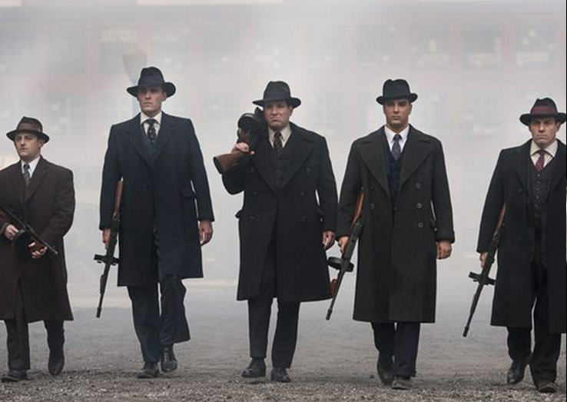
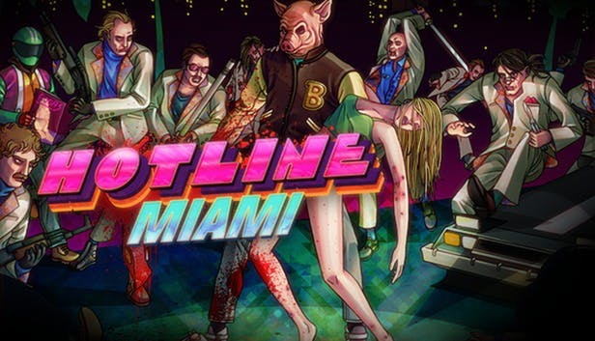
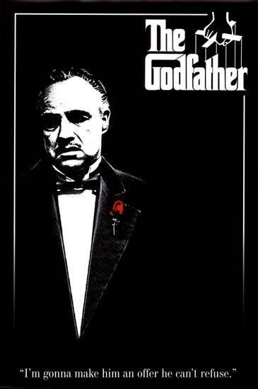
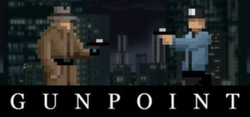
Inspiration

Slide 7


Moodboards

Slide 8

Any questions?

